Slide 2
The Macro Backdrop Remains Difficult

Slide 3
But Heightened Global Tensions Haven’t Affected Growth Yet

Slide 4
Real Estate Performance Moderating

Slide 5
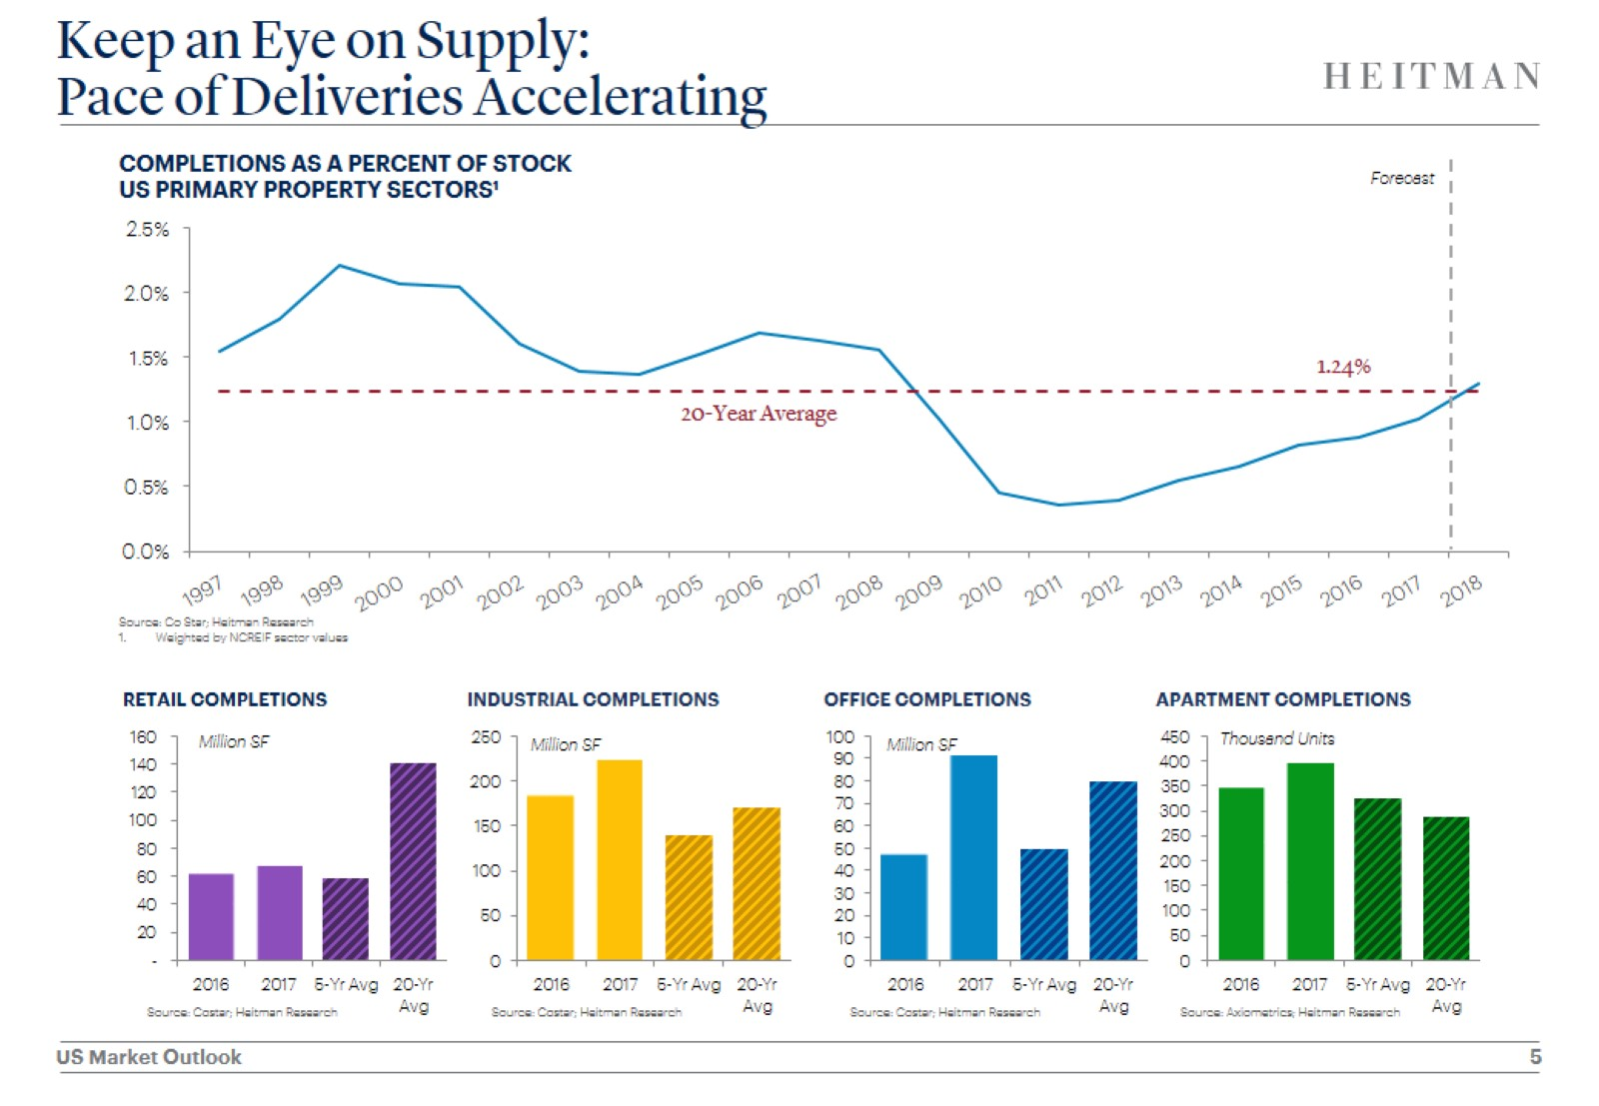
Keep an Eye on Supply: Pace of Deliveries Accelerating

Slide 6
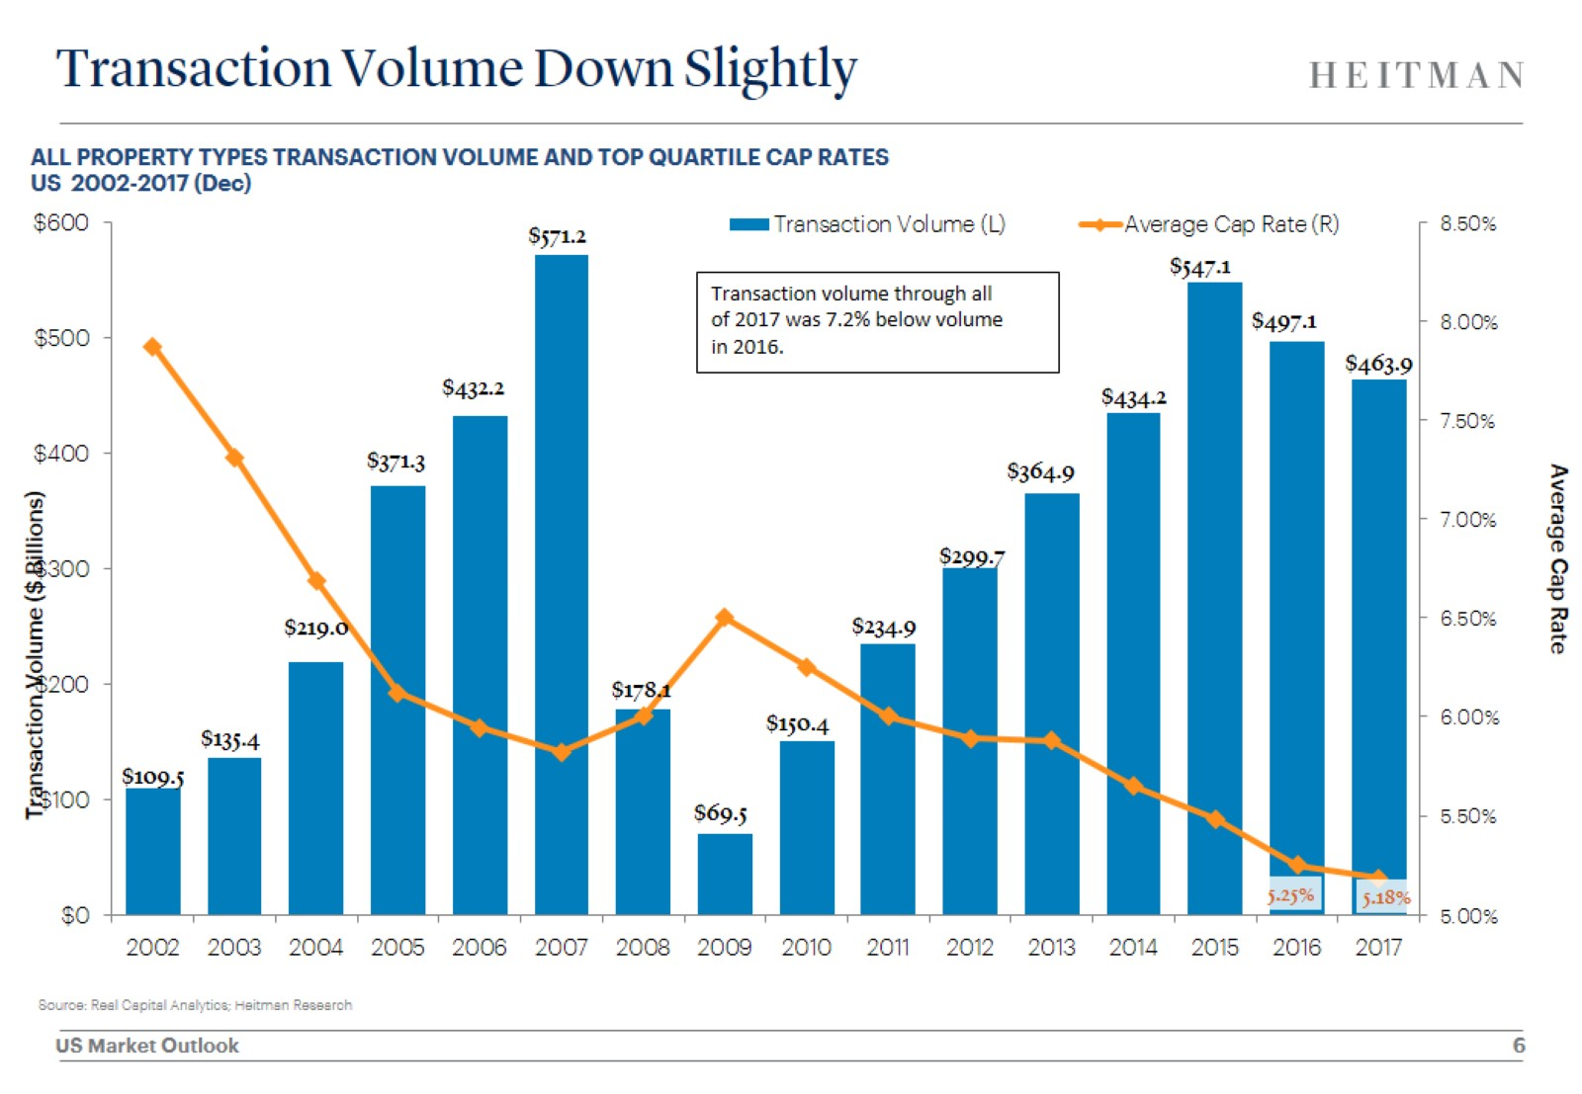
Transaction Volume Down Slightly

Slide 7
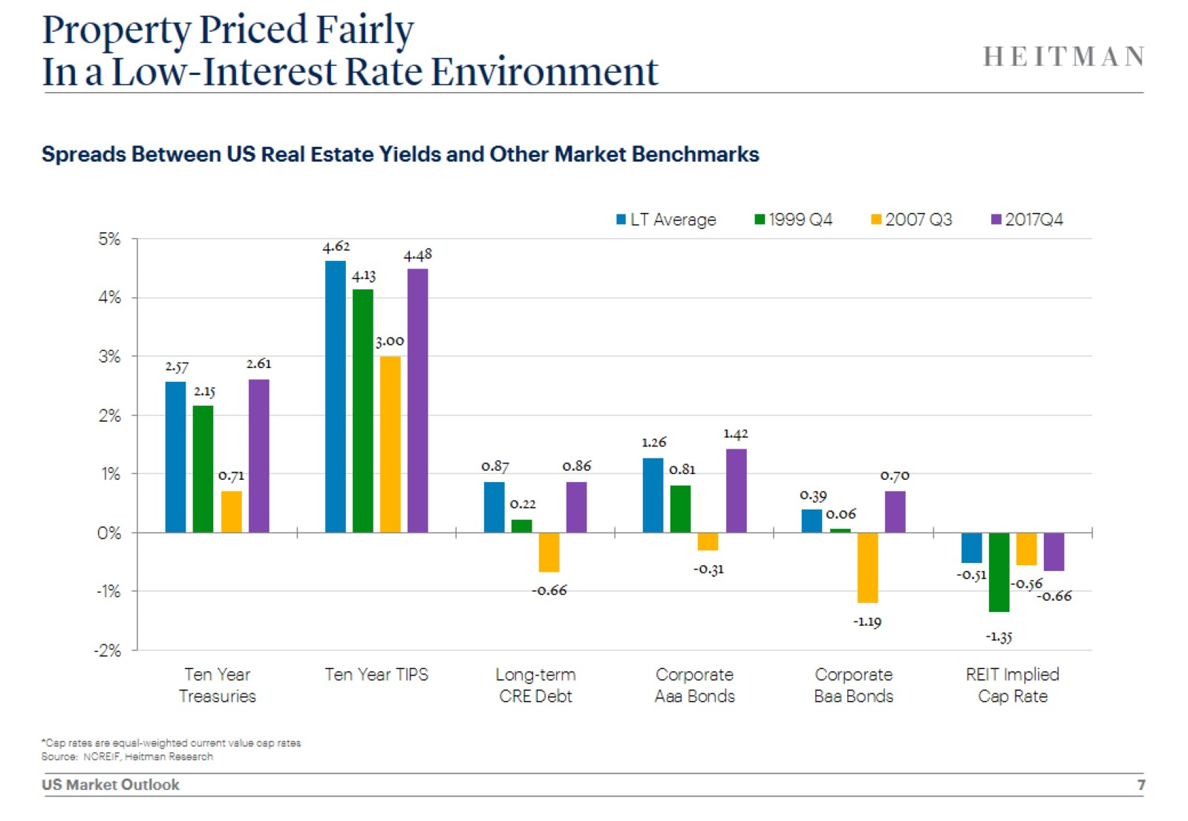
Property Priced Fairly In a Low-Interest Rate Environment

Slide 8
Rising Interest Rates Don’t Necessarily Imply Rising Cap Rates

Slide 9
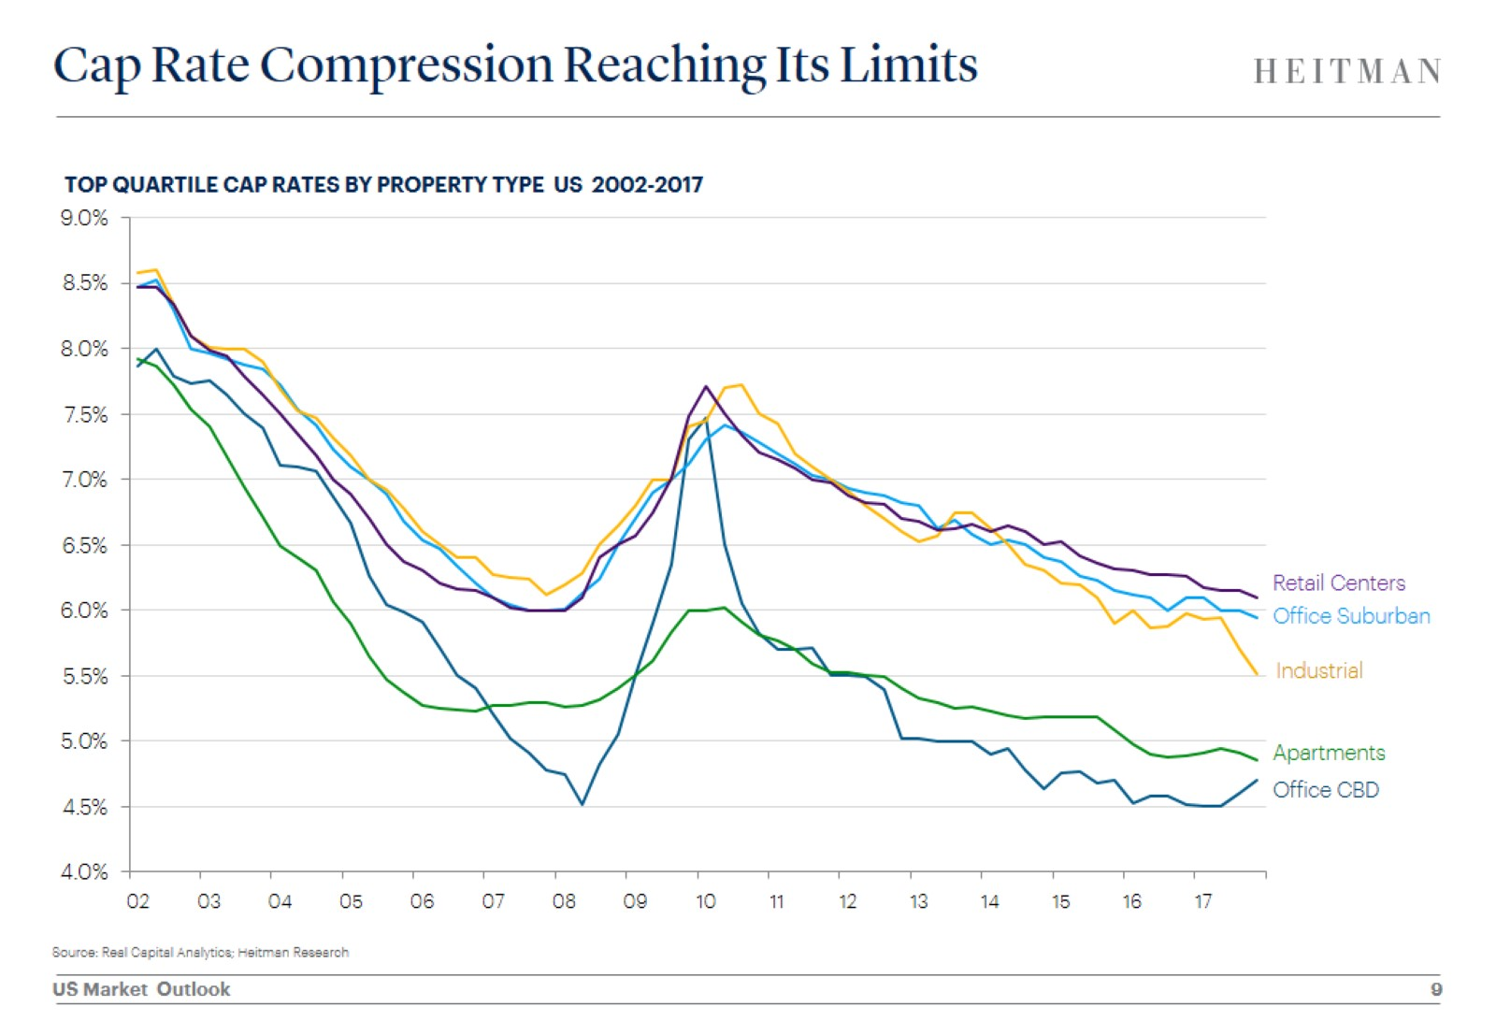
Cap Rate Compression Reaching Its Limits

Slide 10
Yields Are Expected to Stay Low Given High Level of Deployable Capital

Slide 11
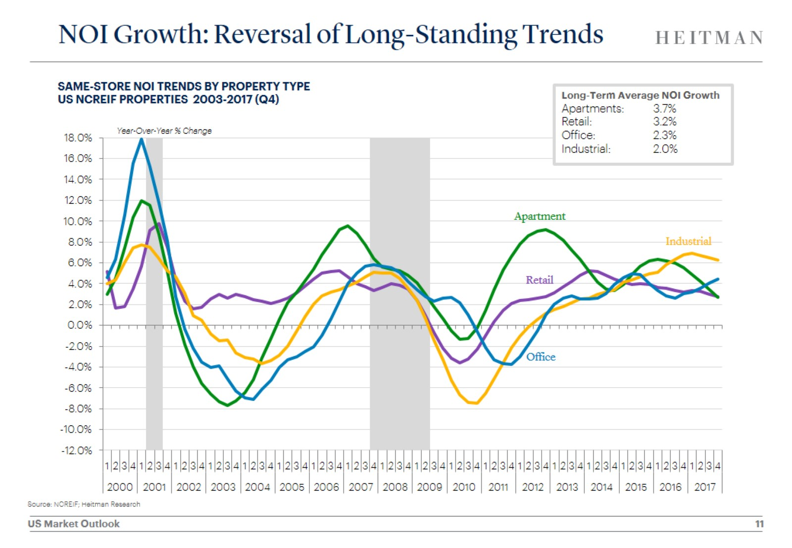
NOI Growth: Reversal of Long-Standing Trends

Slide 12
Apartment Fundamentals Moderating But Remain Healthy

Slide 13
Rent Concessions Rising Along With New Apartment Deliveries

Slide 14
Where Apartments are Being Built has Shifted

Slide 15
Renter Household Formations Slowing

Slide 16
But Long-Term Demographic Shifts Supportive of Apartment Demand

Slide 17
Rent Growth Moderating Sun Belt Markets Remain Strongest Performers

Slide 18
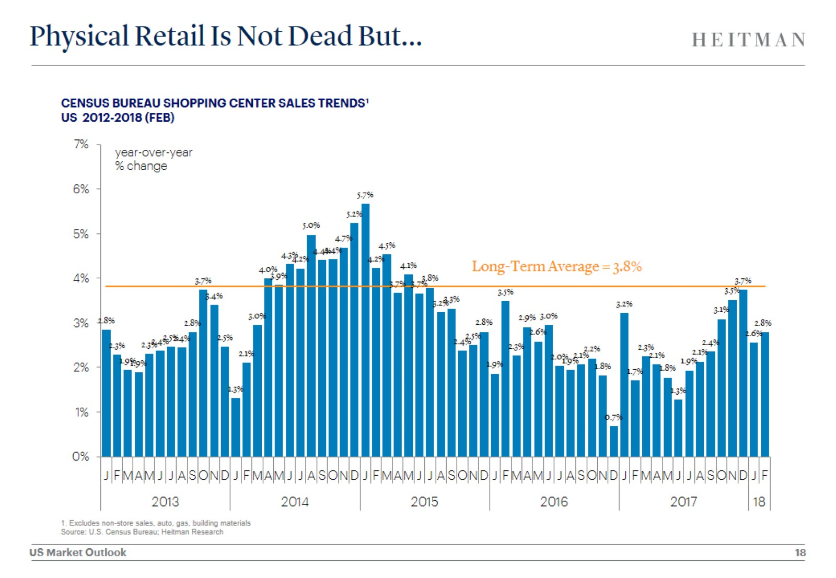
Physical Retail Is Not Dead But…

Slide 19
Evolution in Shopping Patterns Has Widened Gap Between Winners and Losers

Slide 20
E-commerce Isn’t Killing Department Stores, Discounters Are

Slide 21
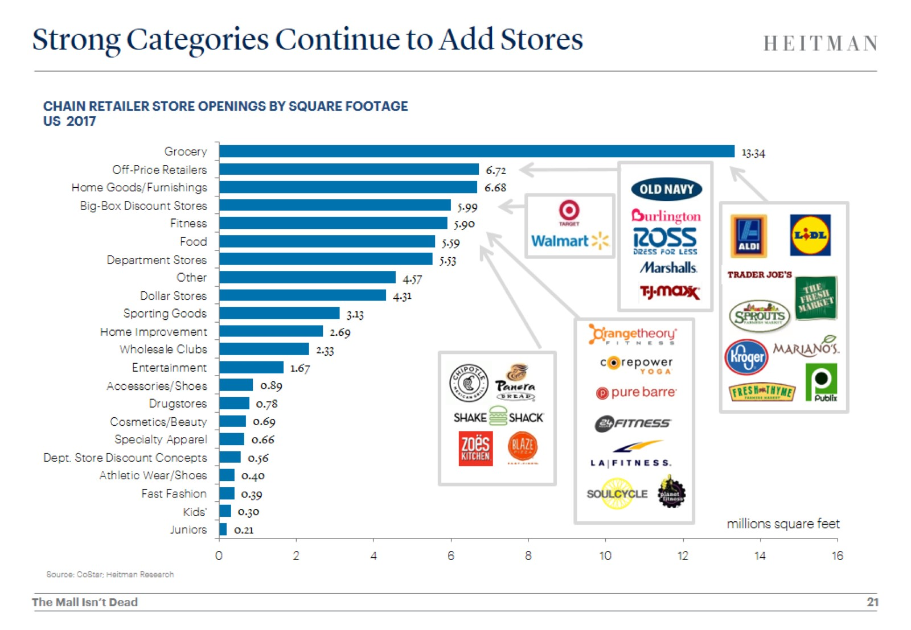
Strong Categories Continue to Add Stores

Slide 22
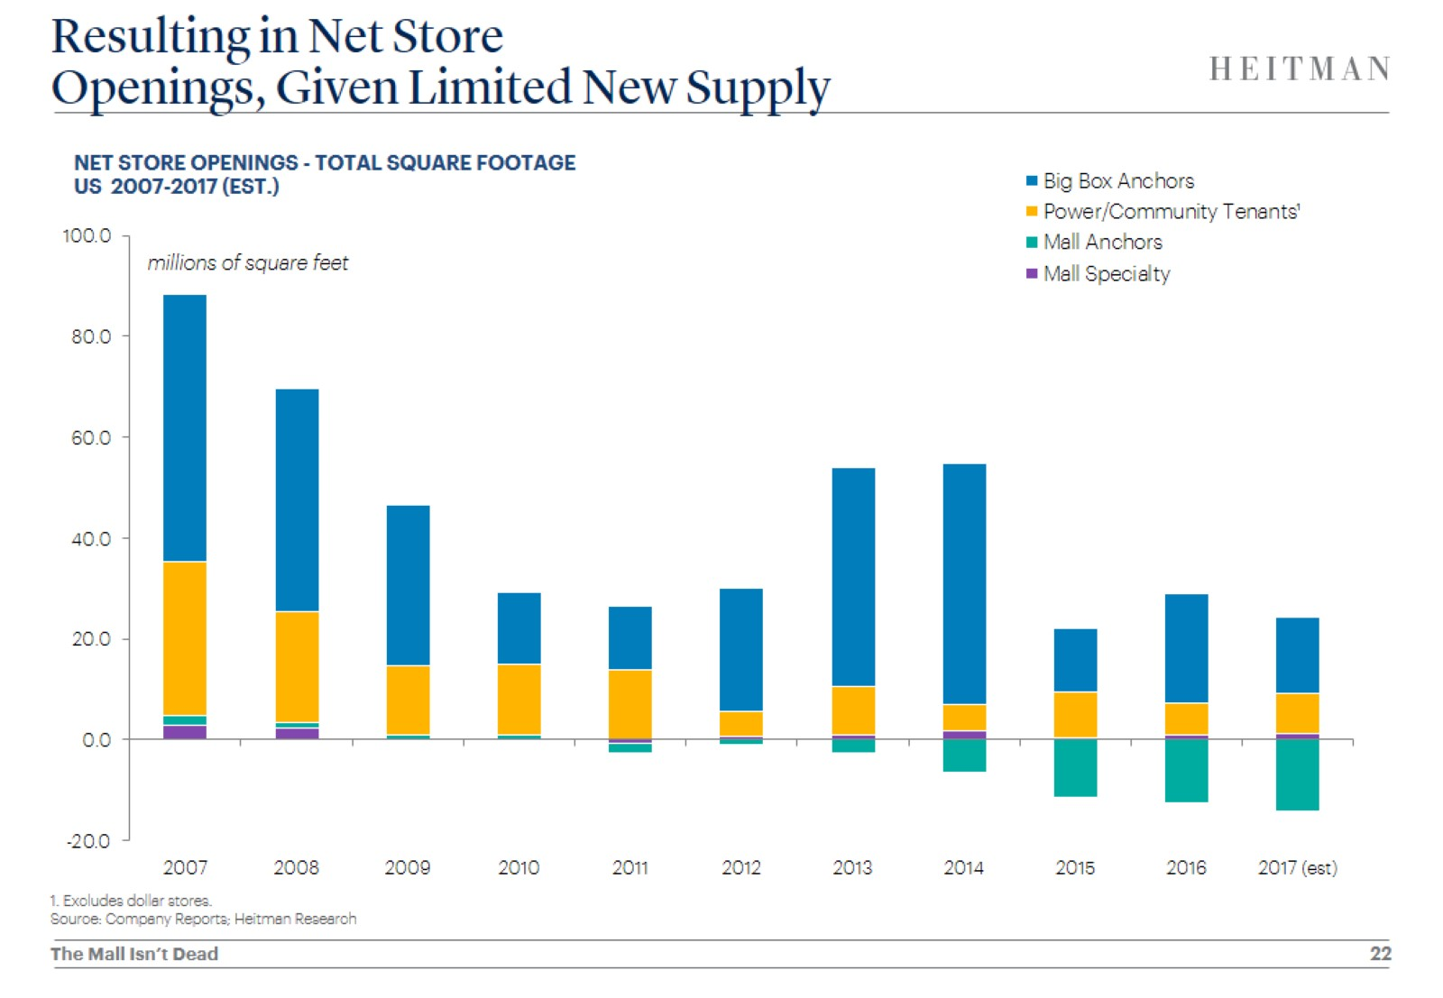
Resulting in Net Store Openings, Given Limited New Supply

Slide 23
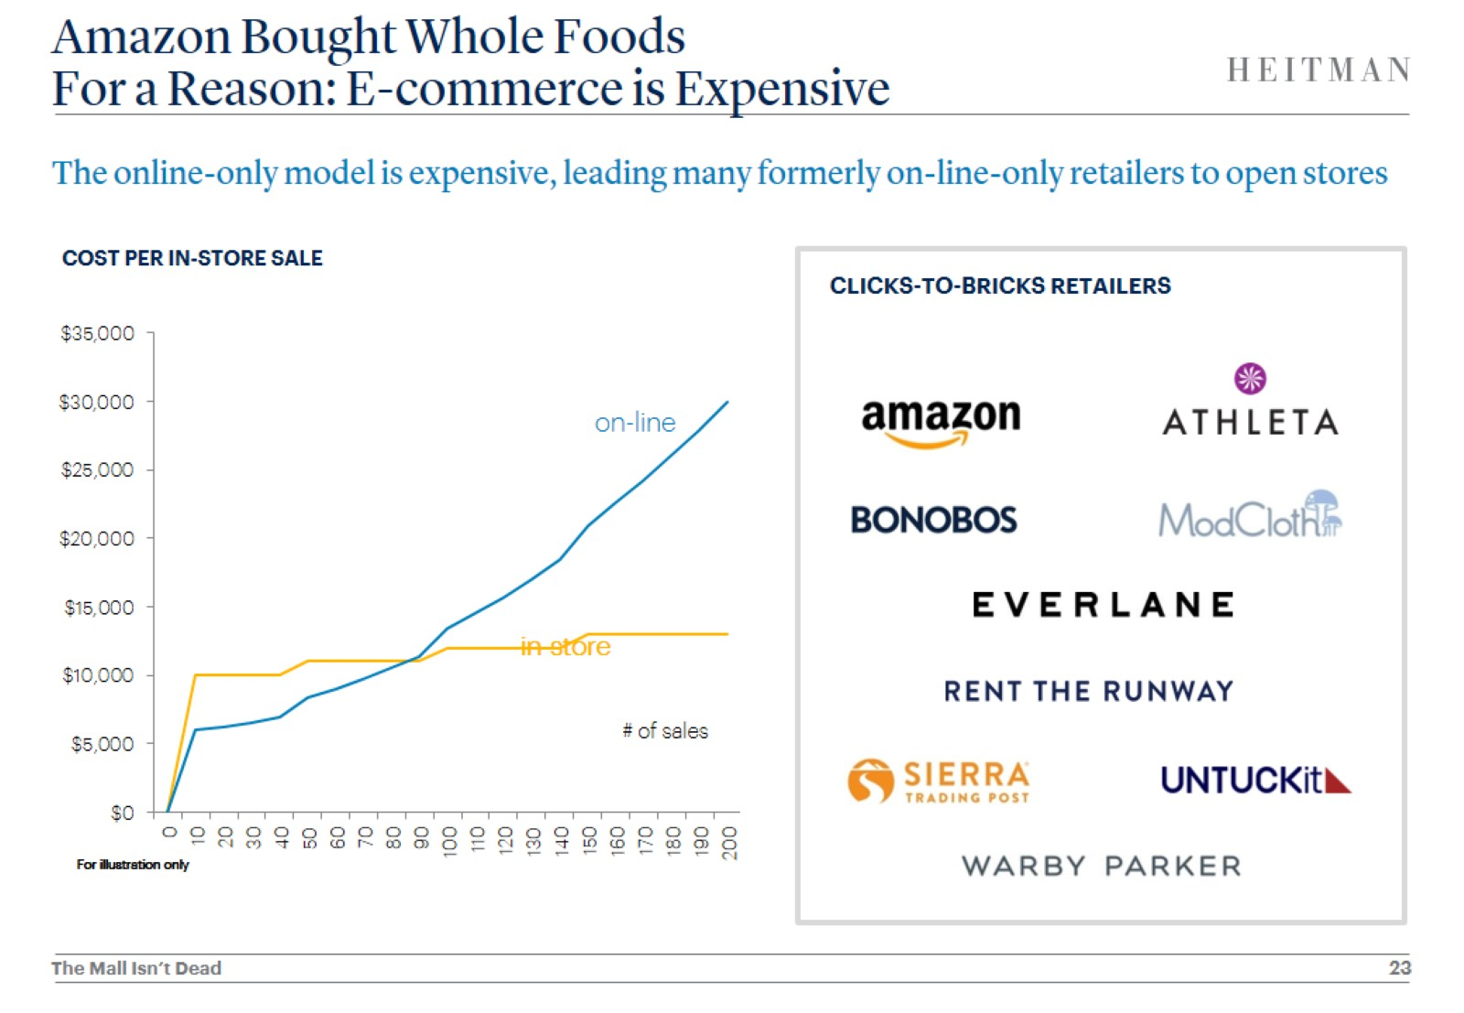
Amazon Bought Whole Foods For a Reason: E-commerce is Expensive

Slide 24
Innovation and Disruption are Nothing New Among Retailers

Slide 25
Nor is Change New in Physical Retail

Slide 26
Quality Pays Off in Retail Investments

Slide 27
But Margins are Falling for Retailers and Landlords

Slide 28
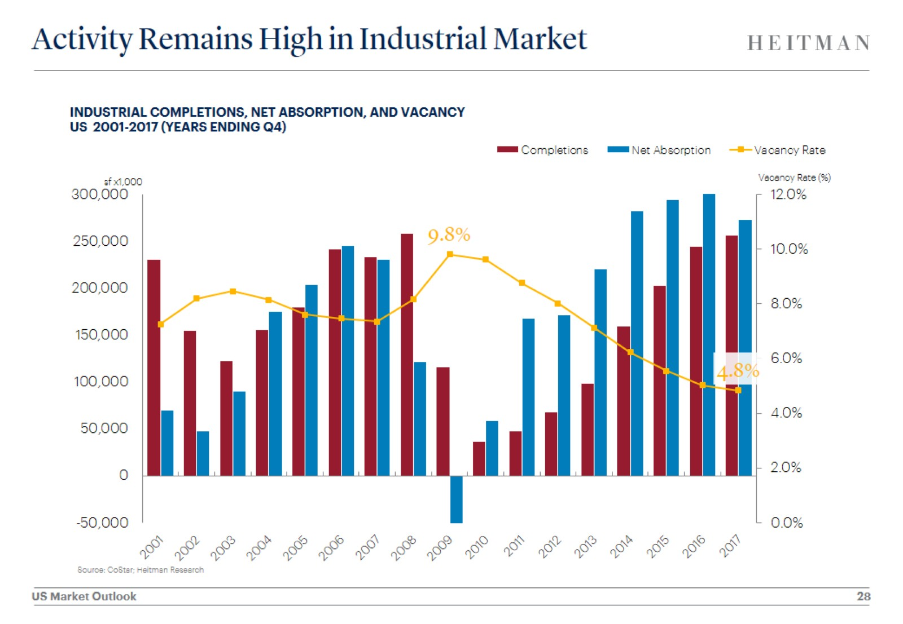
Activity Remains High in Industrial Market

Slide 29
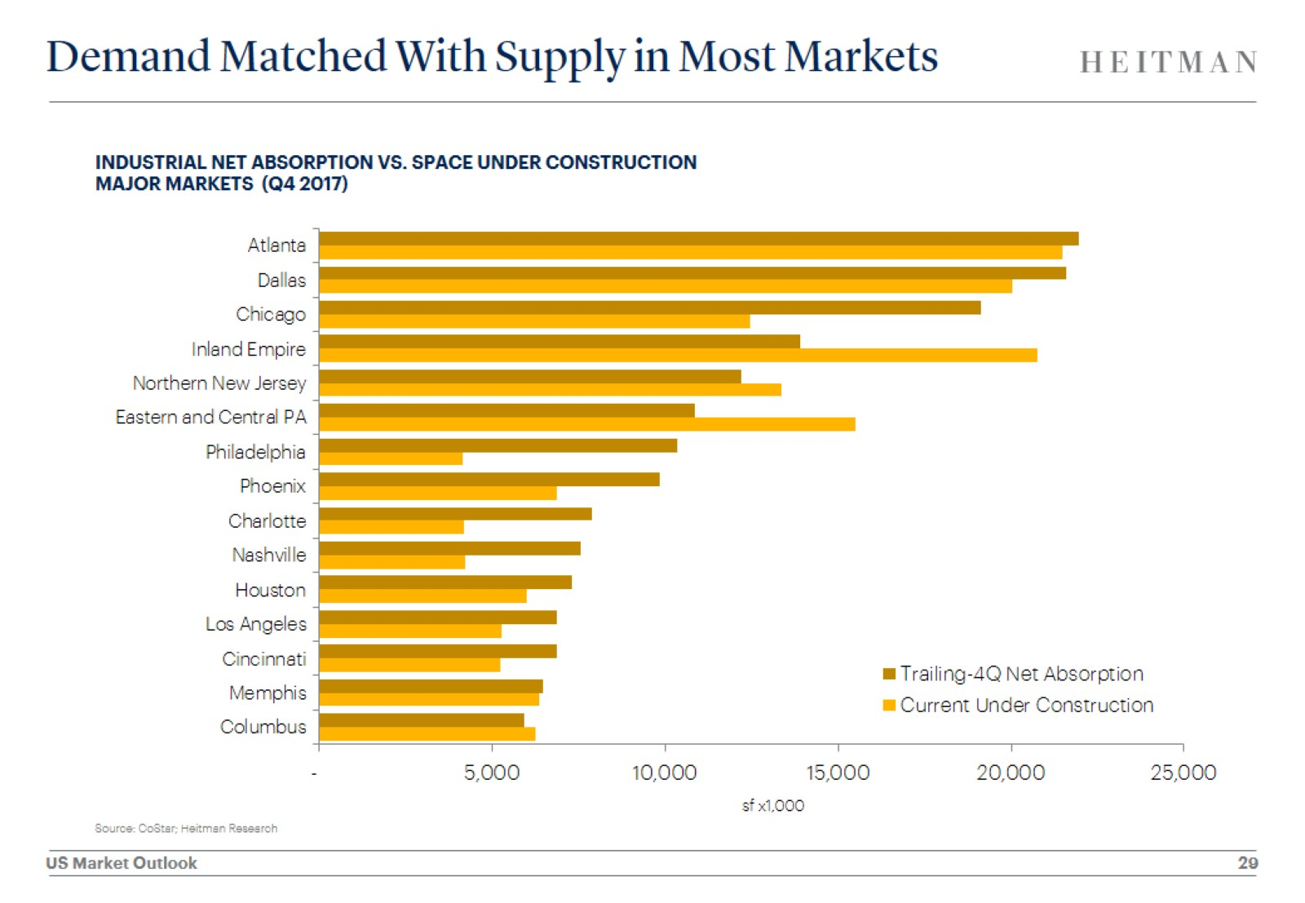
Demand Matched With Supply in Most Markets

Slide 30
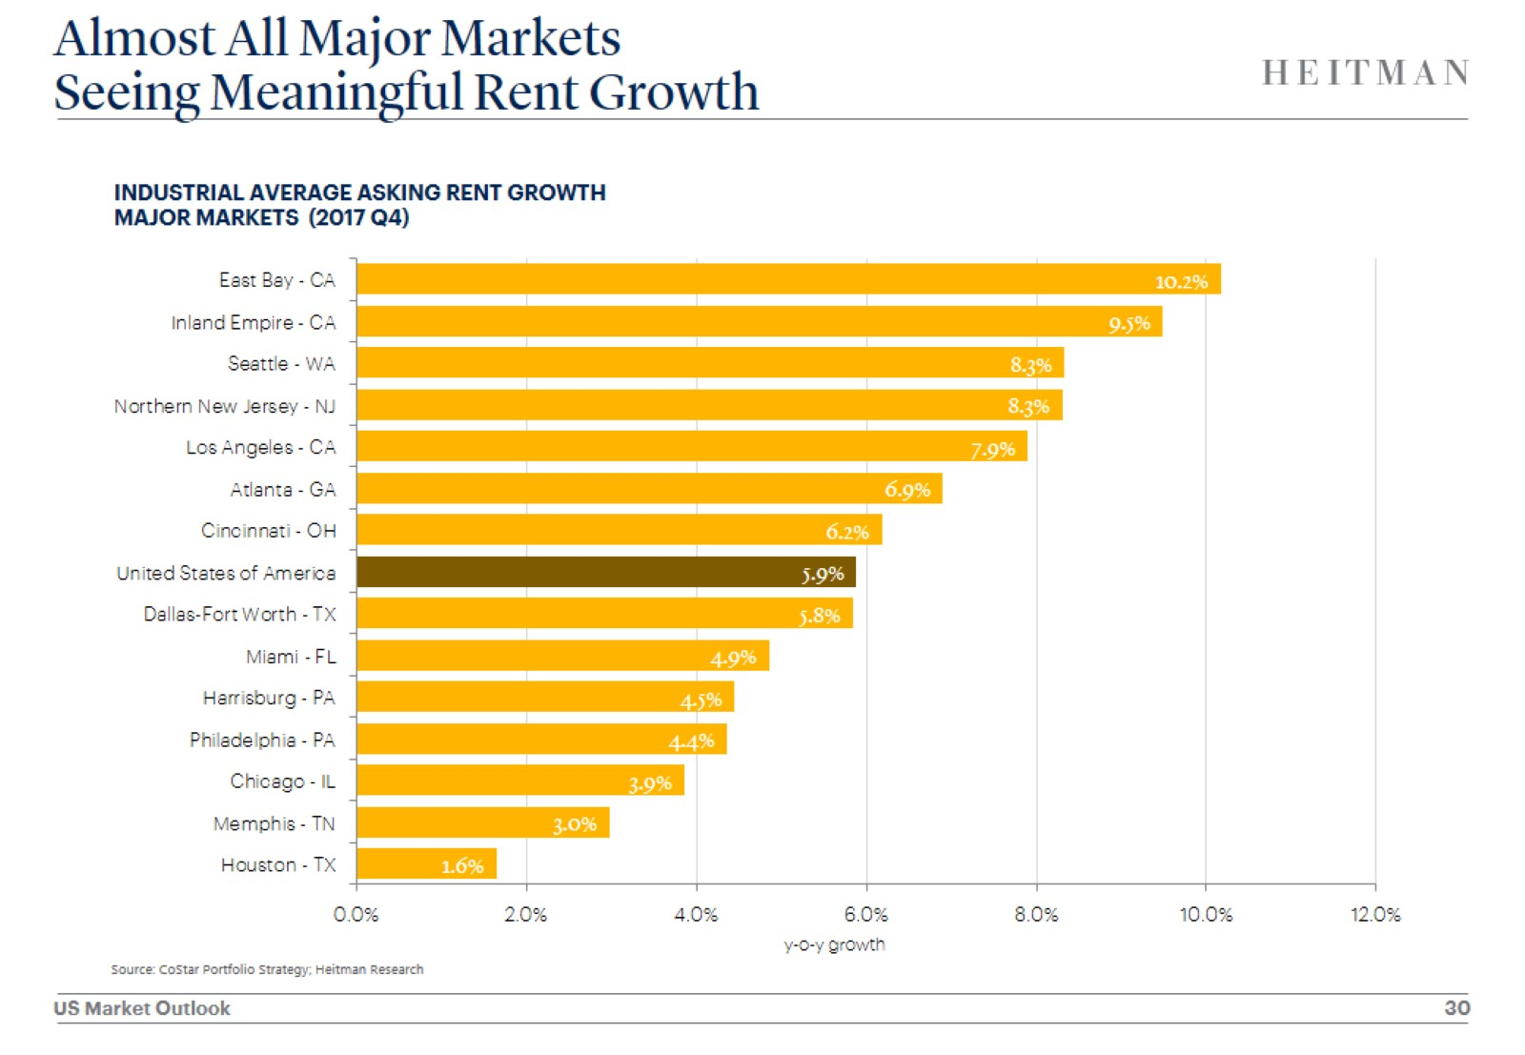
Almost All Major Markets Seeing Meaningful Rent Growth

Slide 31
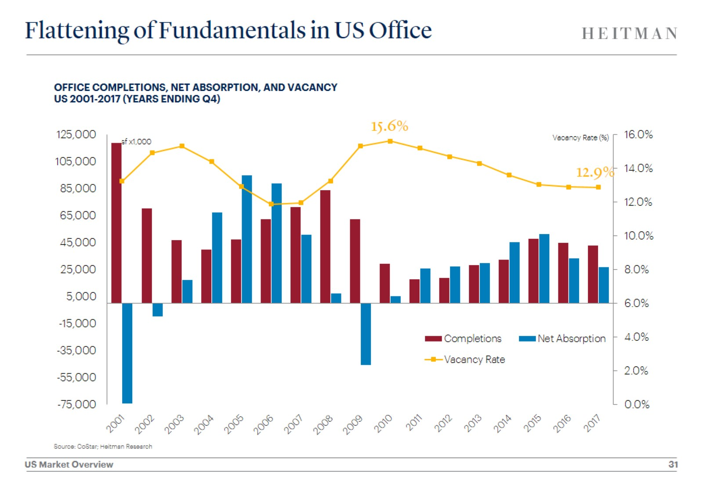
Flattening of Fundamentals in US Office

Slide 32
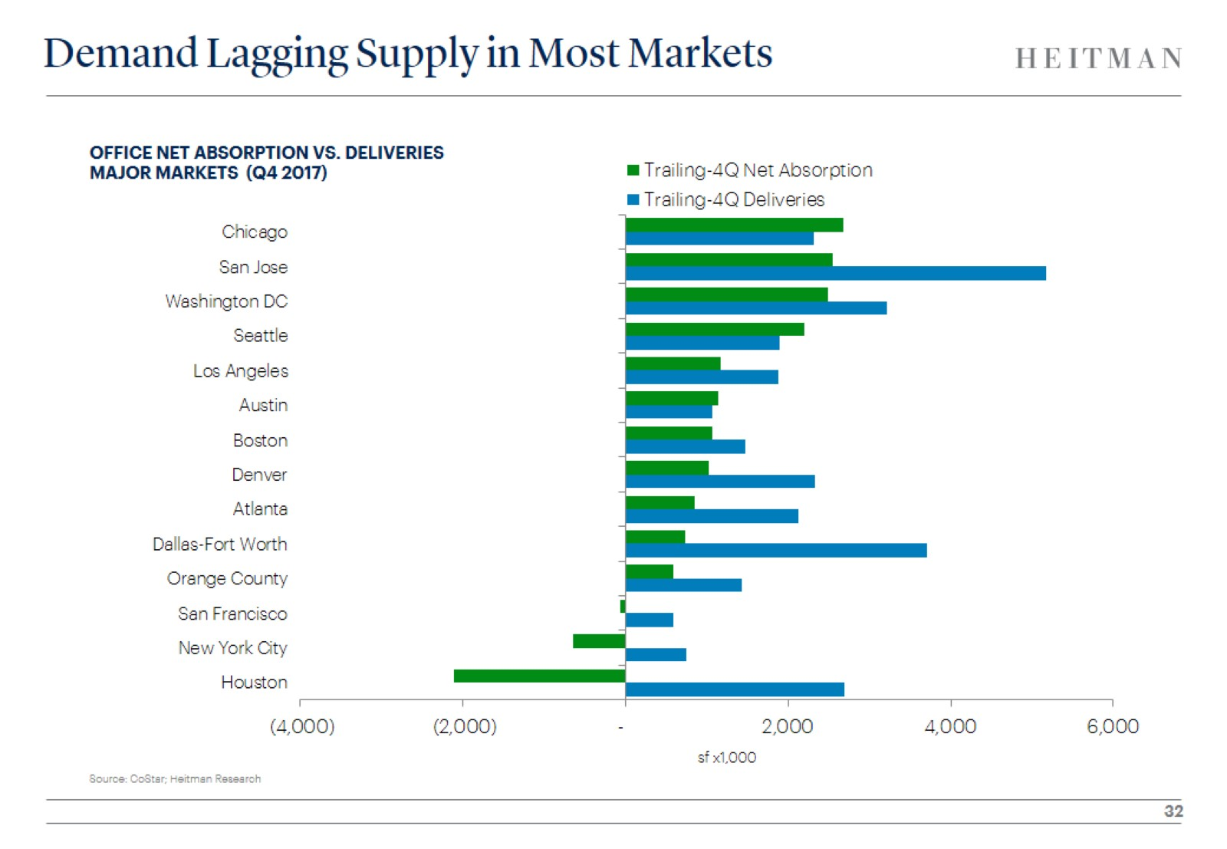
Demand Lagging Supply in Most Markets

Slide 33
Tech Hubs Outperform, Most Populous Metros Fall Behind

Slide 34
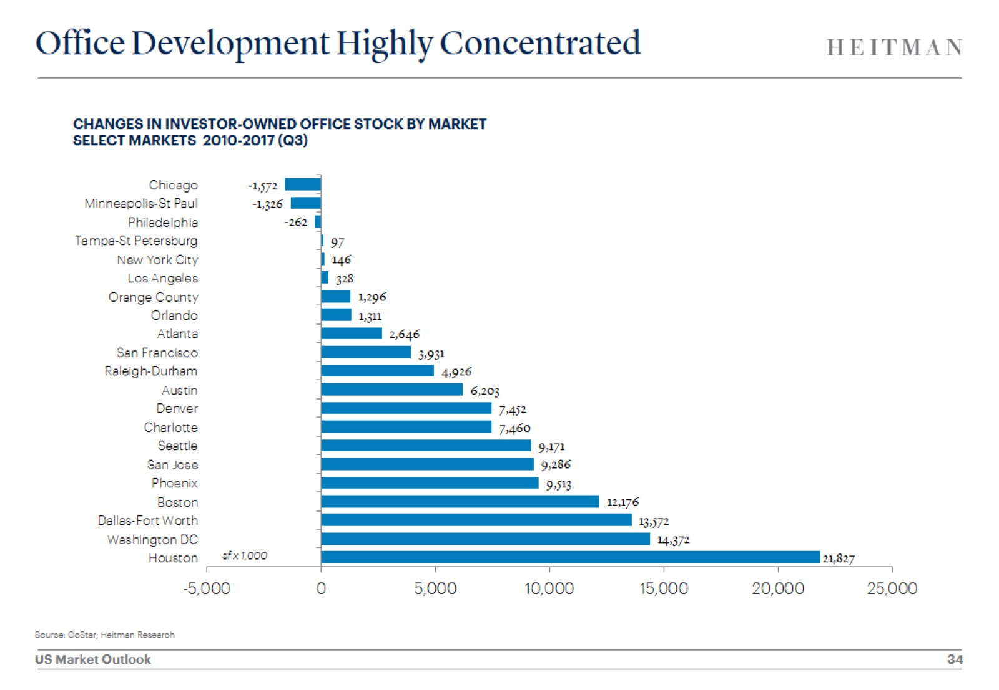
Office Development Highly Concentrated

Slide 35
In Uncertain Times, Specialty Sector Investments Provide Stability

Slide 36
Strategies for Today’s Environment

